Slide 1

Course: Electronic Engineering UEC001
Topic: Combinational Circuits

Slide 2
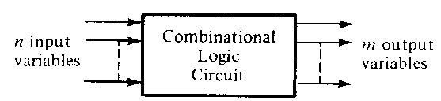
Combinational Circuits
A combinational logic circuit performs an operation assigned logically by a Boolean expression or truth table.
Combinational Circuit is the type of circuit in which output is independent of time and only relies on the input present at that particular instant.
Examples of common combinational logic circuits include: half adders, full adders, multiplexers, demultiplexers, encoders and decoders.

Slide 3
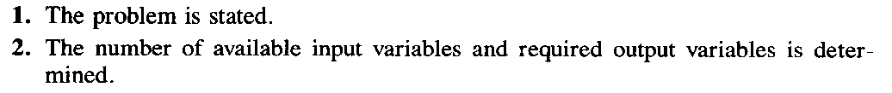
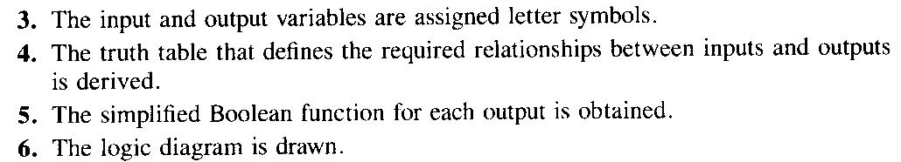
Design Procedure

Slide 4
BCD to XS 3 code converter- Design (1)...
TRUTH TABLE FOR BCD TO XS3 CODE CONVERTER:
Input ( Std BCD code) |  |  |  |  | Output ( XS3 Code)
A | B | C | D | Decimal | w | x | y | z
0 | 0 | 0 | 0 | 0 | 0 | 0 | 1 | 1
0 | 0 | 0 | 1 | 1 | 0 | 1 | 0 | 0
0 | 0 | 1 | 0 | 2 | 0 | 1 | 0 | 1
0 | 0 | 1 | 1 | 3 | 0 | 1 | 1 | 0
0 | 1 | 0 | 0 | 4 | 0 | 1 | 1 | 1
0 | 1 | 0 | 1 | 5 | 1 | 0 | 0 | 0
0 | 1 | 1 | 0 | 6 | 1 | 0 | 0 | 1
0 | 1 | 1 | 1 | 7 | 1 | 0 | 1 | 0
1 | 0 | 0 | 0 | 8 | 1 | 0 | 1 | 1
1 | 0 | 0 | 1 | 9 | 1 | 1 | 0 | 0
1 | 0 | 1 | 0 | 10 | X | X | X | X
1 | 0 | 1 | 1 | 11 | X | X | X | X
1 | 1 | 0 | 0 | 12 | X | X | X | X
1 | 1 | 0 | 1 | 13 | X | X | X | X
1 | 1 | 1 | 0 | 14 | X | X | X | X
1 | 1 | 1 | 1 | 15 | X | X | X | X

Slide 5
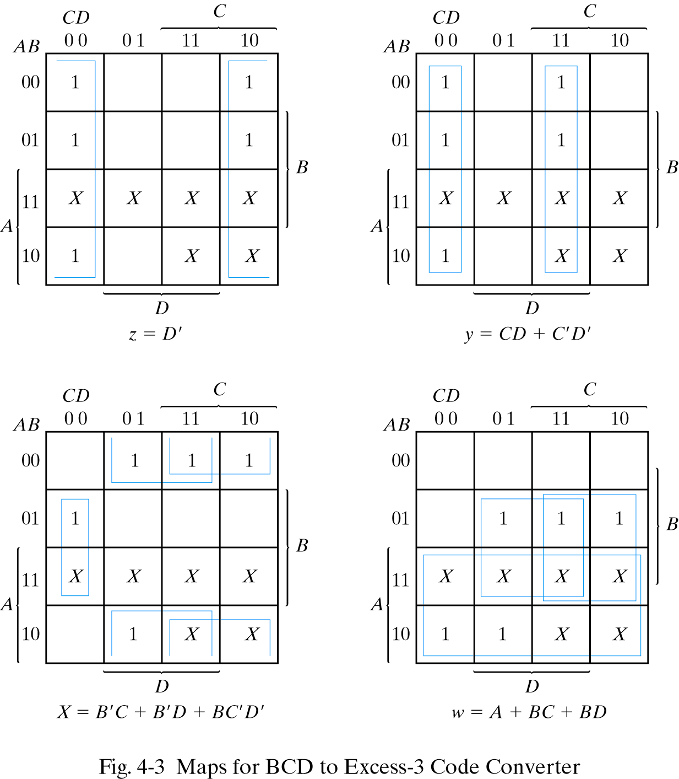
BCD to XS 3 code converter- Design (2)...
K-maps for simplification and simplified Boolean expressions

Slide 6

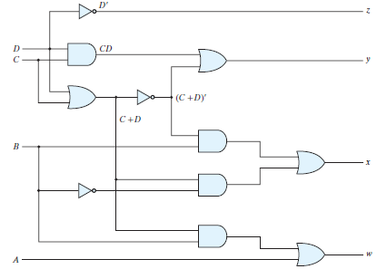
Assignment: Design circuit for BCD to XS 3 code converter-

Slide 7
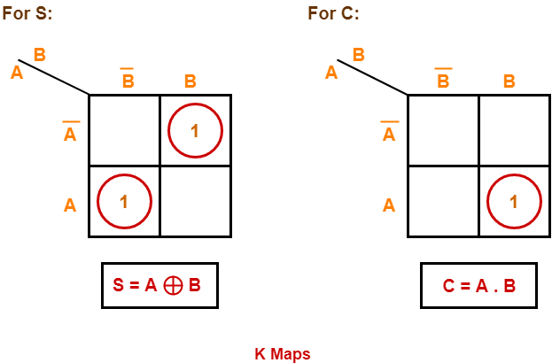
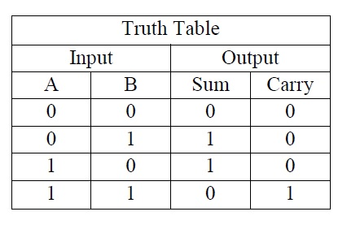
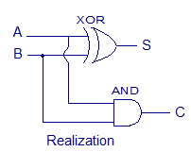
Half Adder
A half adder is a type of adder, an electronic circuit that performs the addition of numbers. The half adder is able to add two single binary digits and provide the output plus a carry value.

Slide 8
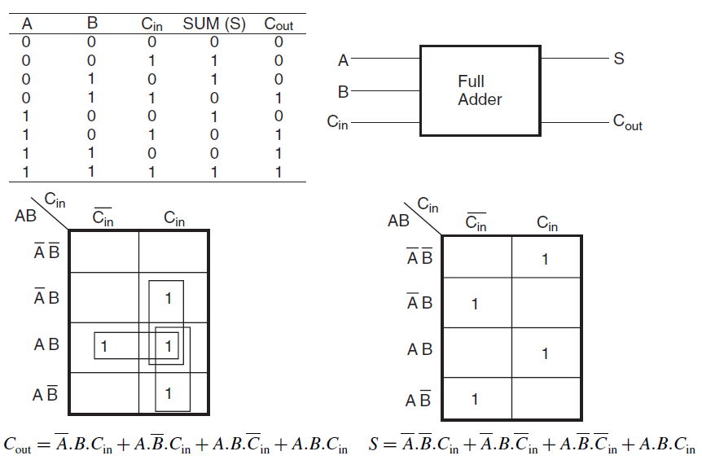
Full Adder

Slide 9
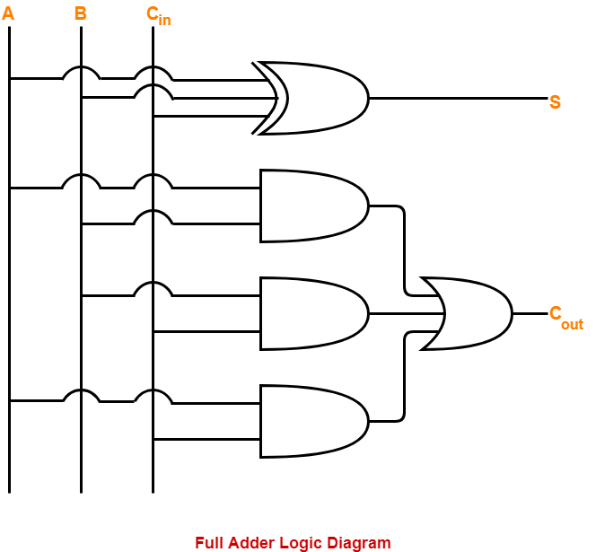
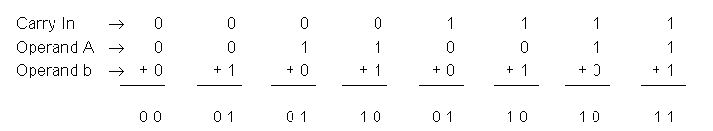
Full Adder
A full adder is a type of adder, an electronic circuit that performs the addition of numbers. The full adder is able to add three single binary digits and provide the output plus a carry value.
= AB+BC+CA

Slide 10
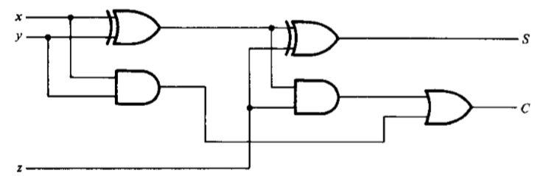
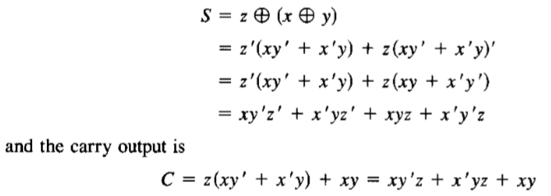

Full Adder with half adder and OR gate

Slide 11
Half Subtractor
The half subtractor is also a building block for subtracting two binary numbers. It has two inputs and two outputs. This circuit is used to subtract two single bit binary numbers A and B. The 'diff' and 'borrow' are two output states of the half subtractor.
A
B
D
C
A
0
0
0
1
0
D
B
0
0 0 0 0
0 1 1 1
1 0 1 0
1 1 0 0
0
C
1
2
1
0
-1
1

Slide 12
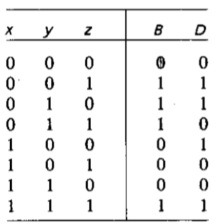

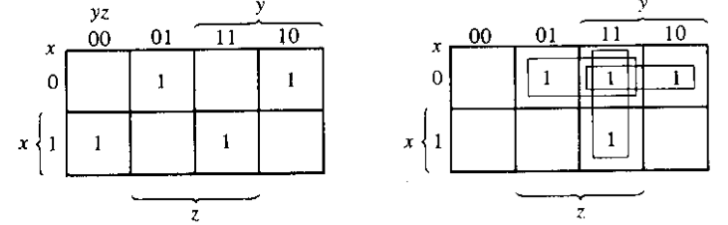
Full Subtractor

Slide 13
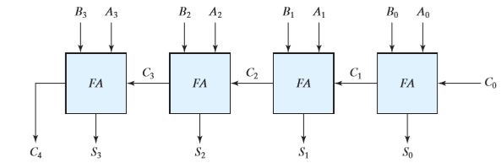
4 Bit Adder

Slide 14
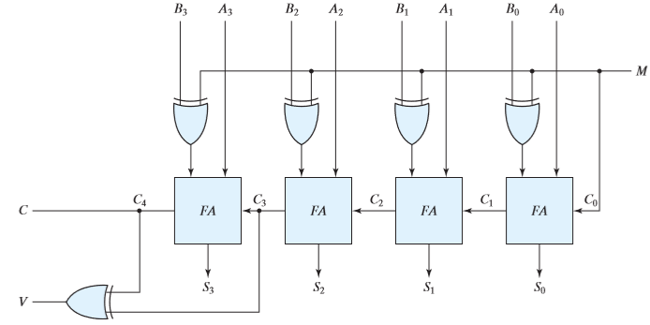
4 Bit Adder-cum-Subtractor

Slide 15
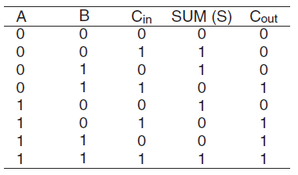

Slide 16
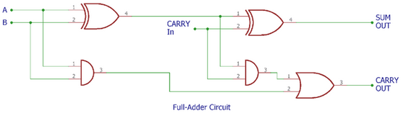
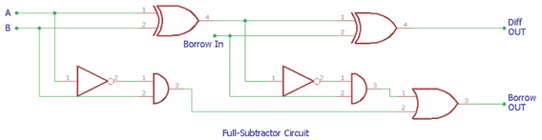

Slide 17
Decoders
W = A'.B'
Out₀
W
B
I₀
Out₁
X
X = A.B'
A
I₁
Out₂
Y
Y = A'.B
Out₃
Z
msb
Z = A.B
Active-high outputs
A | B | W | X | Y | Z
0 | 0 | 1 | 0 | 0 | 0
0 | 1 | 0 | 1 | 0 | 0
1 | 0 | 0 | 0 | 1 | 0
1 | 1 | 0 | 0 | 0 | 1
A decoder is a combinational circuit that converts binary information from n input lines to a maximum of 2^n unique output lines.

Slide 18
Decoder with Enable
Out₀
W
B
I₀
high-level
enable
Out₁
X
A
I₁
Y
Out₂
Out₃
Z
Enable
En
En | A | B | W | X | Y | Z
1 | 0 | 0 | 1 | 0 | 0 | 0
1 | 0 | 1 | 0 | 1 | 0 | 0
1 | 1 | 0 | 0 | 0 | 1 | 0
1 | 1 | 1 | 0 | 0 | 0 | 1
0 | x | x | 0 | 0 | 0 | 0
enabled
disabled

Slide 19
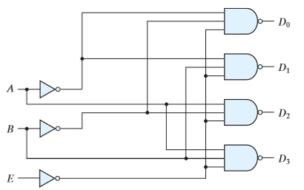
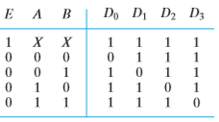
Decoder With enable

Slide 20
Decoders
W = (A'.B')'
Out₀
W
B
I₀
Out₁
X
X = (A.B')'
A
I₁
Out₂
Y
Y = (A'.B)'
Out₃
Z
msb
Z = (A.B)'
Active-low outputs
A | B | W | X | Y | Z
0 | 0 | 0 | 1 | 1 | 1
0 | 1 | 1 | 0 | 1 | 1
1 | 0 | 1 | 1 | 0 | 1
1 | 1 | 1 | 1 | 1 | 0

Slide 21
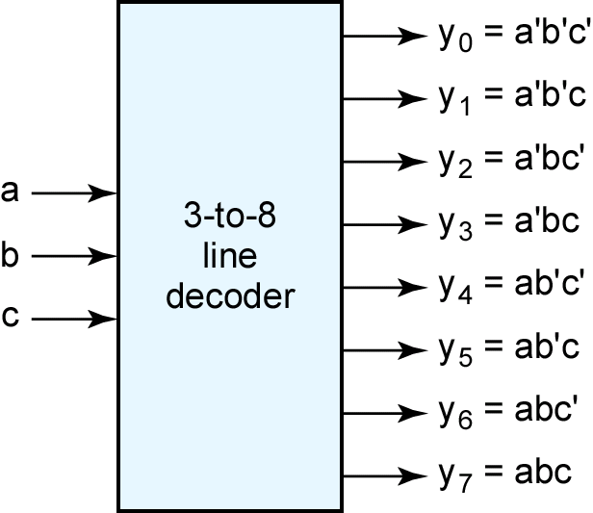
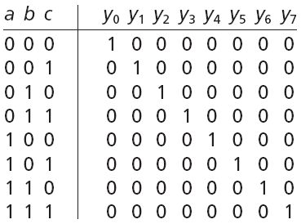
Decoders
msb

Slide 22
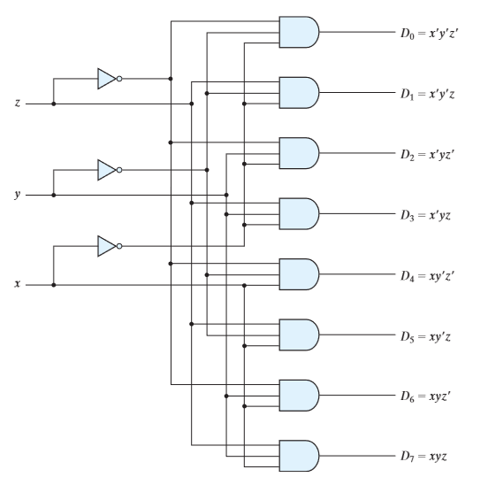
Task: Complete truth Table?

Slide 23
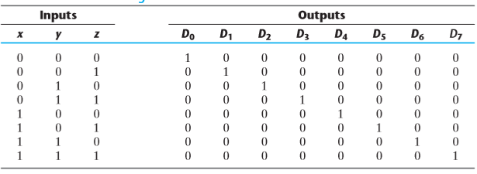
Truth Table

Slide 24
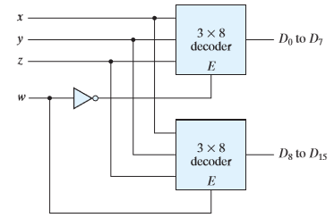

4 * 16 decoder constructed with two 3 * 8 decoders

Slide 25
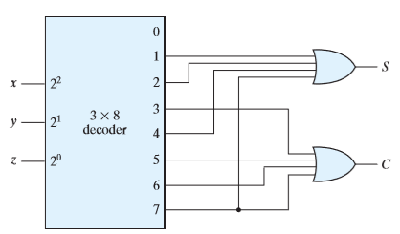

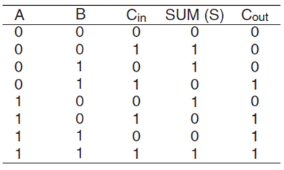

Combinational Logic Implementation

Slide 26
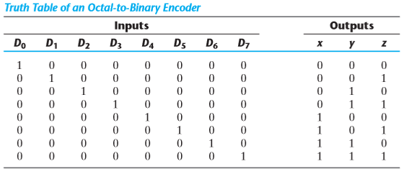
ENCODERS
z = D1 + D3 + D5 + D7
y = D2 + D3 + D6 + D7
x = D4 + D5 + D6 + D7
An Encoder is a combinational circuit that performs the reverse operation of Decoder. It has maximum of 2^{n} input lines and ‘n’ output lines. It will produce a binary code equivalent to the input, which is active High. Therefore, the encoder encodes 2^{n} input lines with ‘n’ bits.

Slide 27
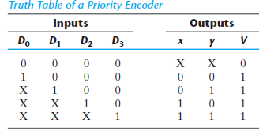
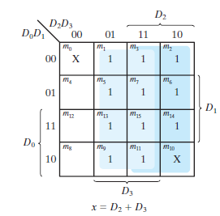

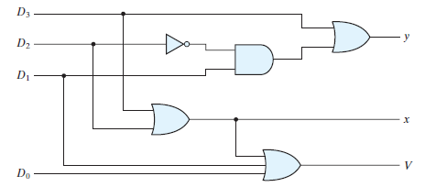
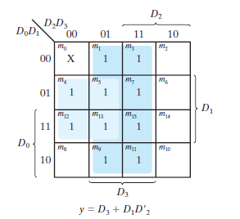


















Priority ENCODERS
if there is more than one input at logic level “1” at the same time, the actual output code would only correspond to the input with the highest designated priority. Then this type of digital encoder is known commonly as a Priority Encoder or P-encoder for short.

Slide 28
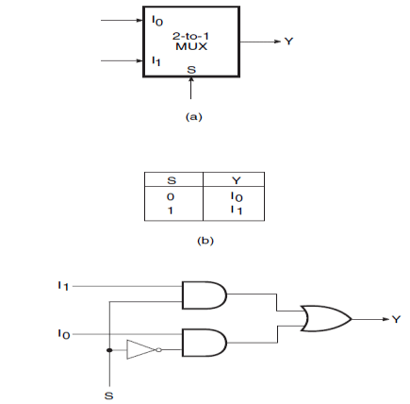
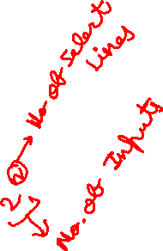
2x1 Multiplexer
A Multiplexer is a device that allows one of several analog or digital input signals which are to be selected and transmits the input that is selected into a single medium. Multiplexer is also known as Data Selector. A multiplexer of 2n inputs has n select lines that will be used to select input line to send to the output. Multiplexer is abbreviated as Mux.

Slide 29
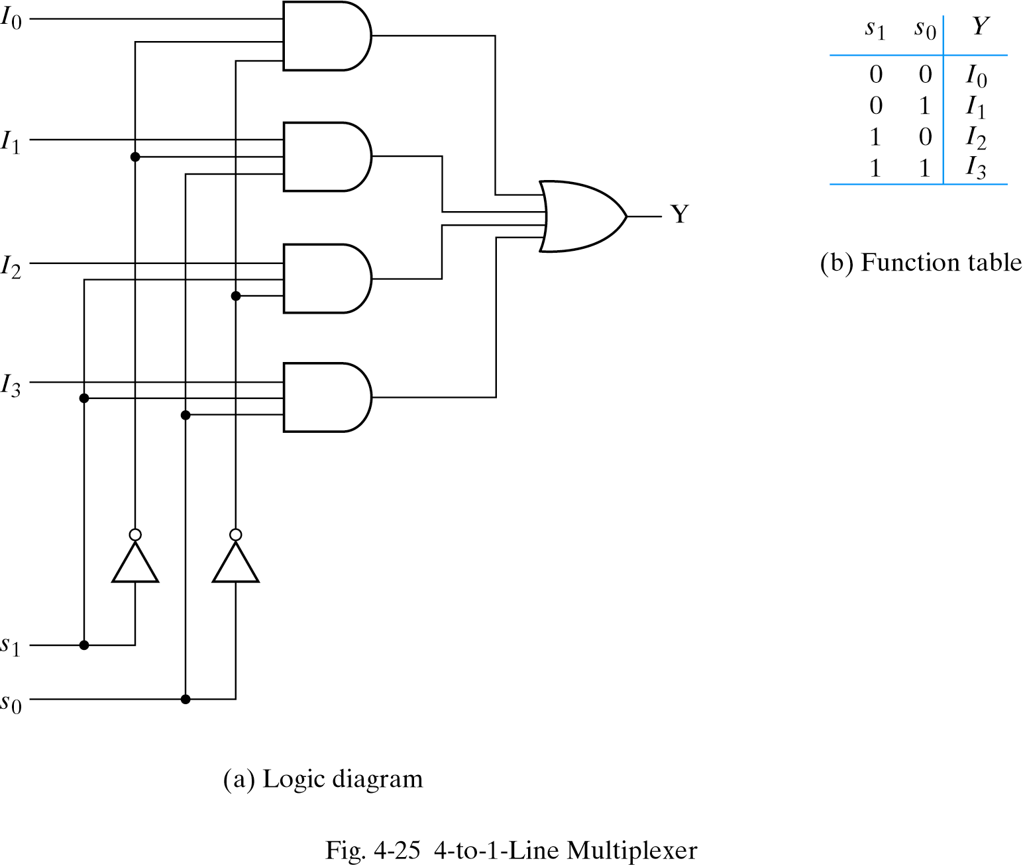
4x1 Multiplexer

Slide 30
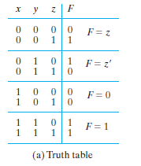
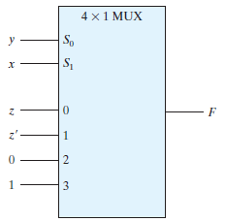


Slide 31
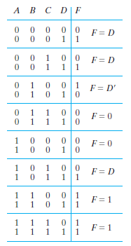
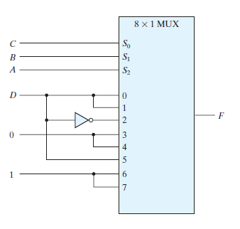


Slide 32
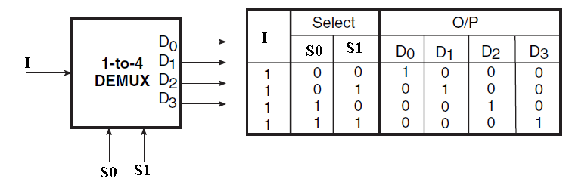
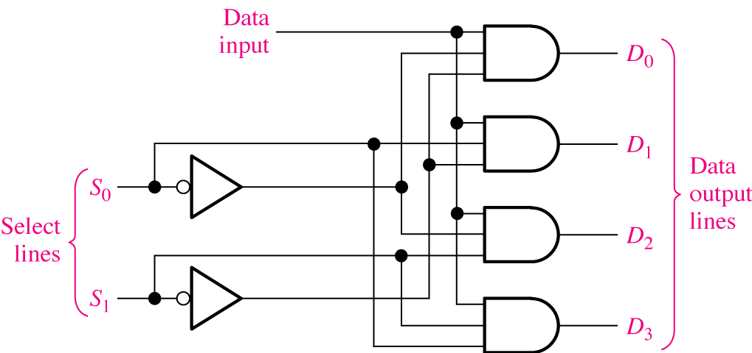
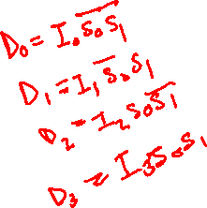
A 1-line-to-4-line demultiplexer.

Slide 33
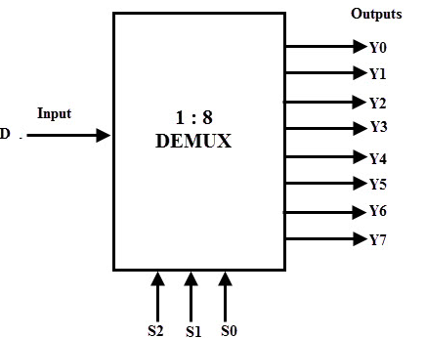
A 1-line-to-8-line demultiplexer.

Slide 34
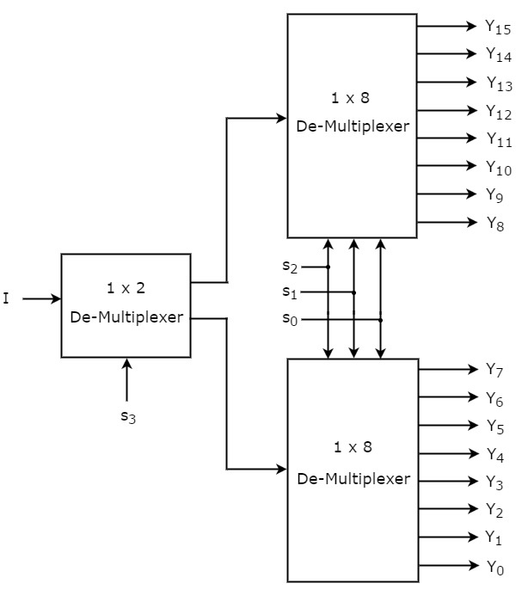

Slide 35
Few Examples for practice

Slide 36
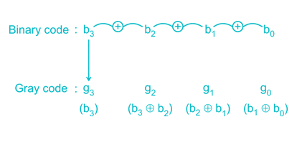
Conversion from Binary code to Gray Code
Let Binary code be b₃ b₂ b₁ b_{0.} Then the respective Gray Code can be obtained is as follows

Slide 37
FOUR BIT BINARY TO GRAY CODE CONVERTER –DESIGN (1)…
MSB
0
+
1
+
1
+
0
+
1
Binary code
TRUTH TABLE:
0
1
0
1
1
Gray code
INPUT ( BINARY) |  |  |  |  | OUTPUTS (GRAY CODE)
B3 | B2 | B1 | B0 |  | G3 | G2 | G1 | G0
0 | 0 | 0 | 0 |  | 0 | 0 | 0 | 0
0 | 0 | 0 | 1 |  | 0 | 0 | 0 | 1
0 | 0 | 1 | 0 |  | 0 | 0 | 1 | 1
0 | 0 | 1 | 1 |  | 0 | 0 | 1 | 0
0 | 1 | 0 | 0 |  | 0 | 1 | 1 | 0
0 | 1 | 0 | 1 |  | 0 | 1 | 1 | 1
0 | 1 | 1 | 0 |  | 0 | 1 | 0 | 1
0 | 1 | 1 | 1 |  | 0 | 1 | 0 | 0
1 | 0 | 0 | 0 |  | 1 | 1 | 0 | 0
1 | 0 | 0 | 1 |  | 1 | 1 | 0 | 1
1 | 0 | 1 | 0 |  | 1 | 1 | 1 | 1
1 | 0 | 1 | 1 |  | 1 | 1 | 1 | 0
1 | 1 | 0 | 0 |  | 1 | 0 | 1 | 0
1 | 1 | 0 | 1 |  | 1 | 0 | 1 | 1
1 | 1 | 1 | 0 |  | 1 | 0 | 0 | 1
1 | 1 | 1 | 1 |  | 1 | 0 | 0 | 0

Slide 38
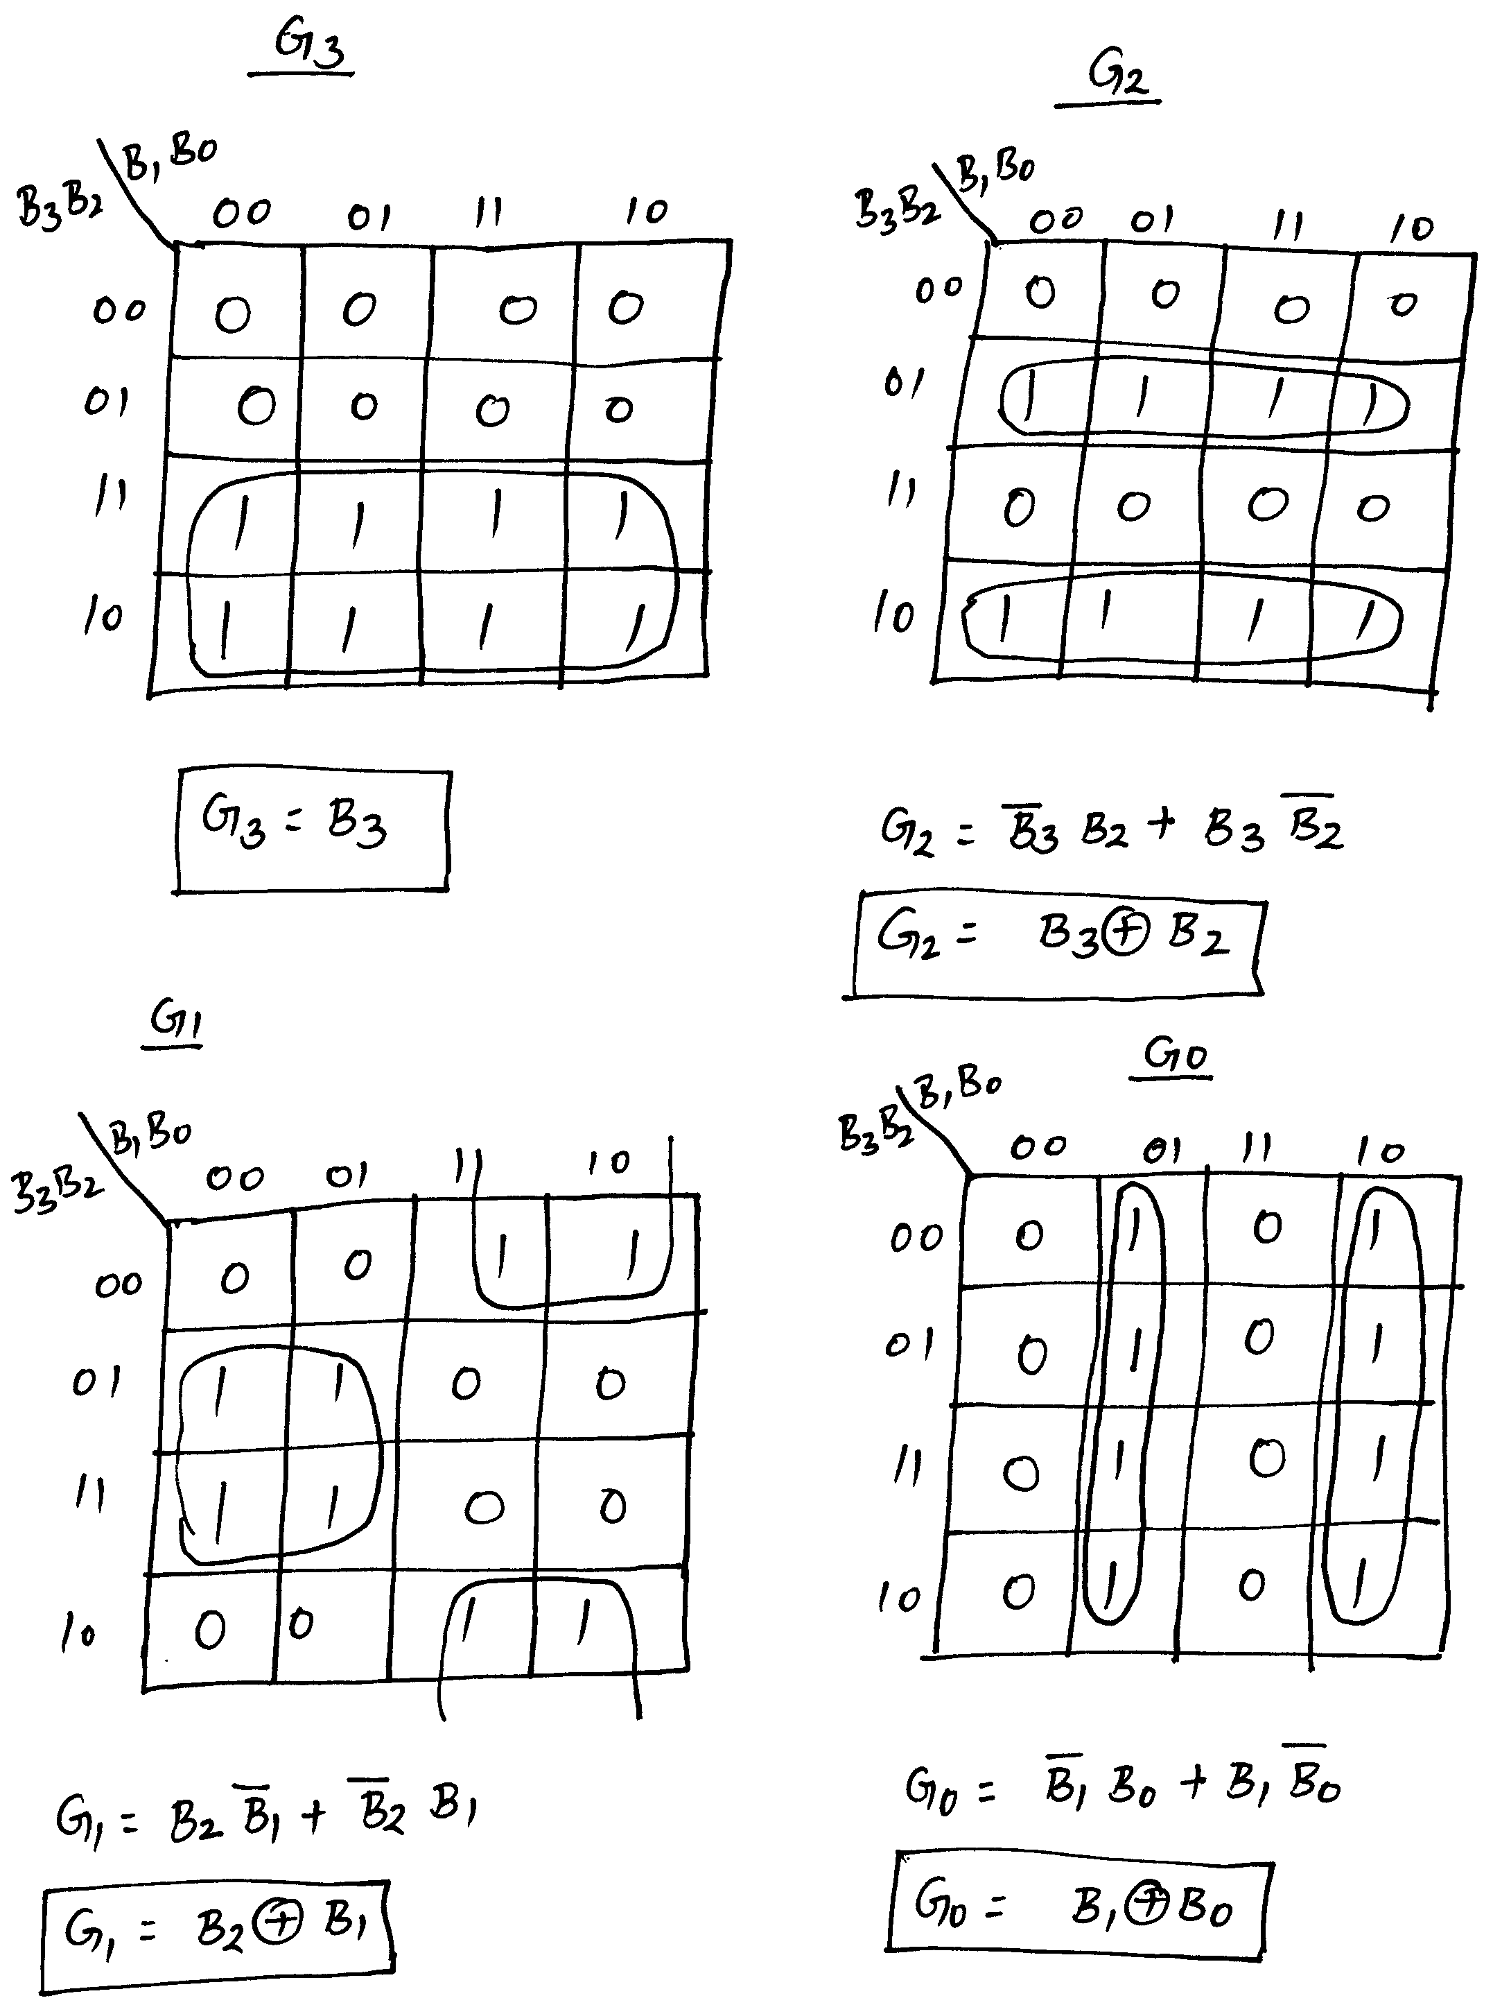
FOUR BIT BINARY TO GRAY CODE CONVERTER –DESIGN (2)…
Simplification using K-maps:

Slide 39
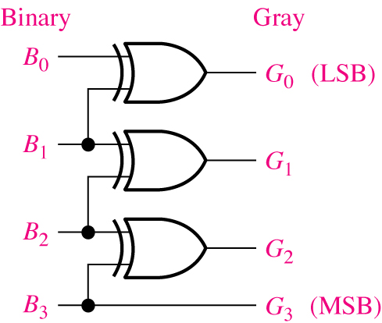
FOUR BIT BINARY TO GRAY CODE CONVERTER –DESIGN (3)
Logic Diagram:

Slide 40
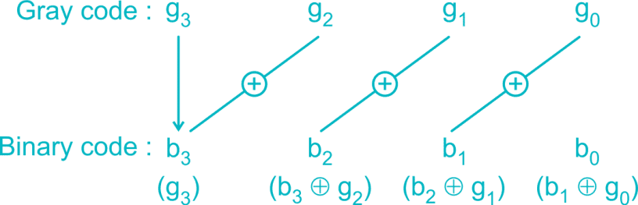
Gray to Binary
Let Gray Code be g₃ g₂ g₁ g₀. Then the respective Binary Code can be obtained as follows:

Slide 41
FOUR BIT GRAY CODE TO BINARY CONVERTER –DESIGN (1)…
MSB
1
+
0
+
1
+
0
+
0
Gray code
Truth Table:
Binary code
1
1
0
0
0
INPUT ( GRAY CODE) |  |  |  |  | OUTPUTS (BINARY )
G3 | G2 | G1 | G0 |  | B3 | B2 | B1 | B0
0 | 0 | 0 | 0 |  | 0 | 0 | 0 | 0
0 | 0 | 0 | 1 |  | 0 | 0 | 0 | 1
0 | 0 | 1 | 0 |  | 0 | 0 | 1 | 1
0 | 0 | 1 | 1 |  | 0 | 0 | 1 | 0
0 | 1 | 0 | 0 |  | 0 | 1 | 1 | 1
0 | 1 | 0 | 1 |  | 0 | 1 | 1 | 0
0 | 1 | 1 | 0 |  | 0 | 1 | 0 | 0
0 | 1 | 1 | 1 |  | 0 | 1 | 0 | 1
1 | 0 | 0 | 0 |  | 1 | 1 | 1 | 1
1 | 0 | 0 | 1 |  | 1 | 1 | 1 | 0
1 | 0 | 1 | 0 |  | 1 | 1 | 0 | 0
1 | 0 | 1 | 1 |  | 1 | 1 | 0 | 1
1 | 1 | 0 | 0 |  | 1 | 0 | 0 | 0
1 | 1 | 0 | 1 |  | 1 | 0 | 0 | 1
1 | 1 | 1 | 0 |  | 1 | 0 | 1 | 1
1 | 1 | 1 | 1 |  | 1 | 0 | 1 | 0

Slide 42

FOUR BIT GRAY CODE TO BINARY CONVERTER –DESIGN (2)…
Simplification using K-Maps:

Slide 43

FOUR BIT GRAY CODE TO BINARY CONVERTER –DESIGN (3)…
Simplification using K-Maps:

Slide 44

FOUR BIT GRAY CODE TO BINARY CONVERTER –DESIGN (4)
Logic Diagram:

